Slide 1

FULL STACK PROJECT: BAKERY AND RESTRO WEBSITE
Presented By:-
Abhishek Gupta(181500017)
Akansha Gupta(181500053)
Anushka Maheshwari(181500124)
Kajol Gupta(181500303)

Slide 2

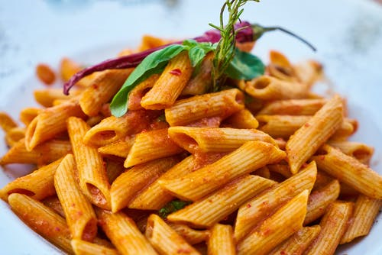
PROBLEM STATEMENT
Restaurant is a kind of business that serves people all over world with ready made food.
People feel more comfortable with lot of variations in the selection and consumption of their food in their busy life.

Slide 3

TOUR TO APPLICATION
Sign-Up:- Allow Users and Bakers to sign-in to their Account.
Register:- Allow new user to register into application.

Slide 4
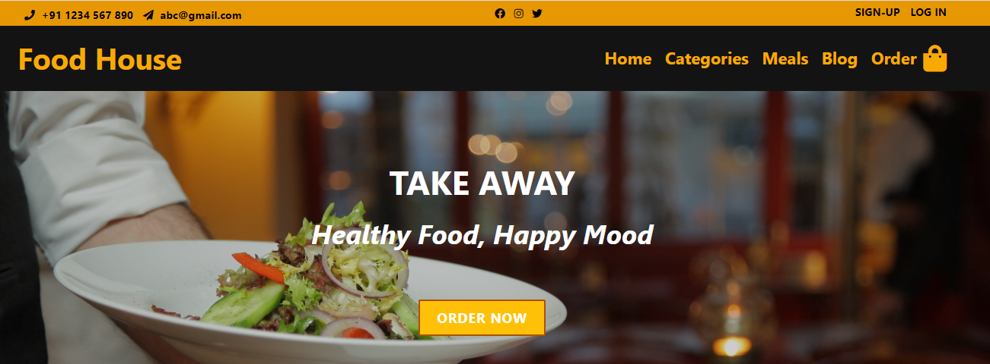
FEATURES FOR USER SECTION
Order Now:- Allow user to access products and order their favourite meals which we want.
Place Order:- Allow user to order the delicious meals which we want to eat with full satisfaction. and pay theor bill accordingly.
Subscribe Now:- Allow user to select more sample available designs and order from them.

Slide 5
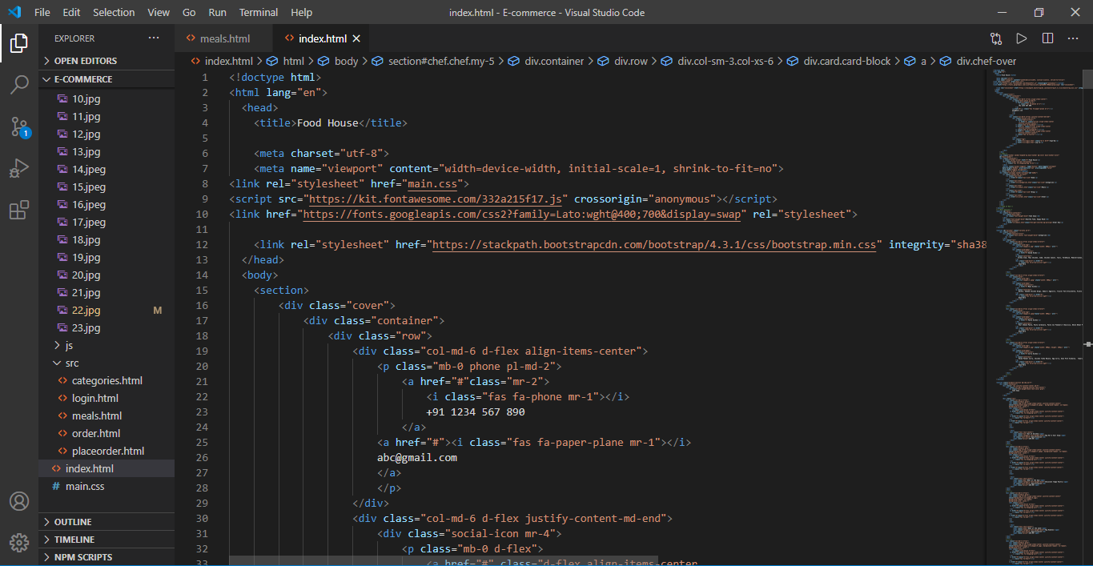
CODE SNIPPET

Slide 6
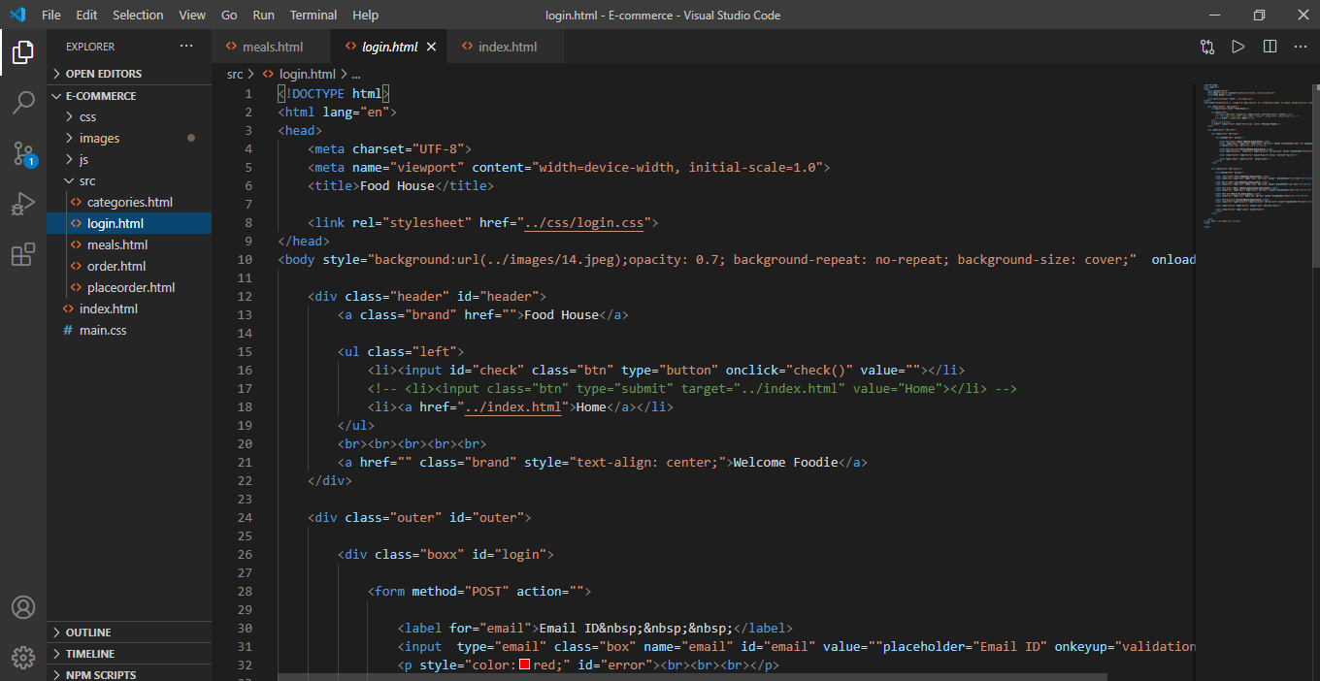

Slide 7
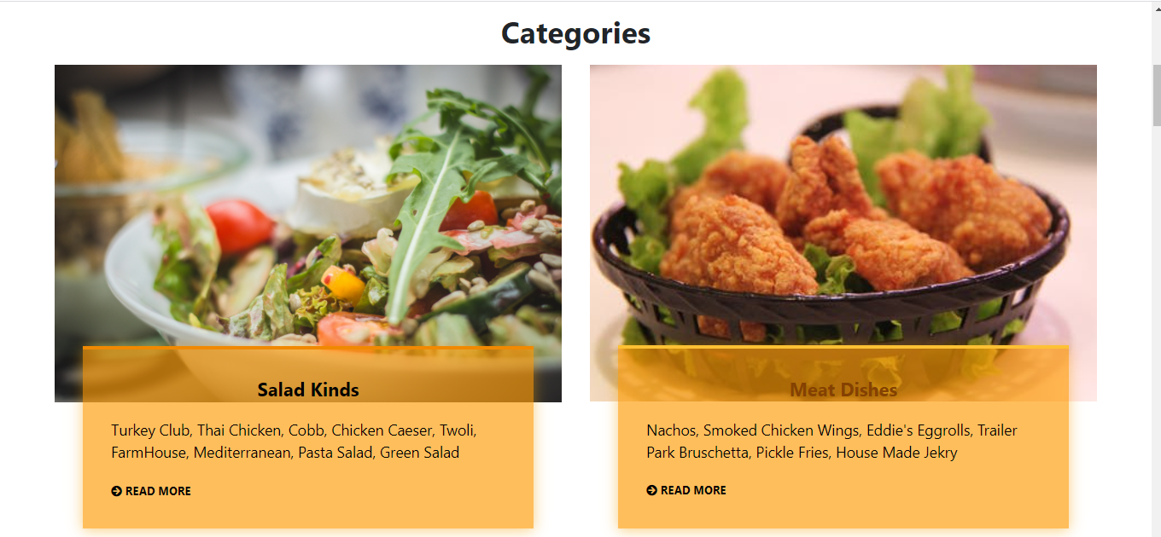
WEBSITE LAYOUT

Slide 8
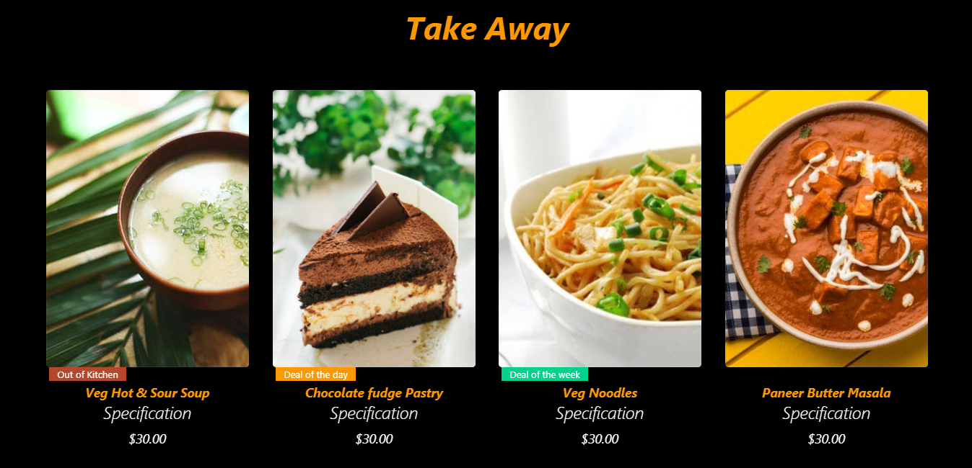

Slide 9
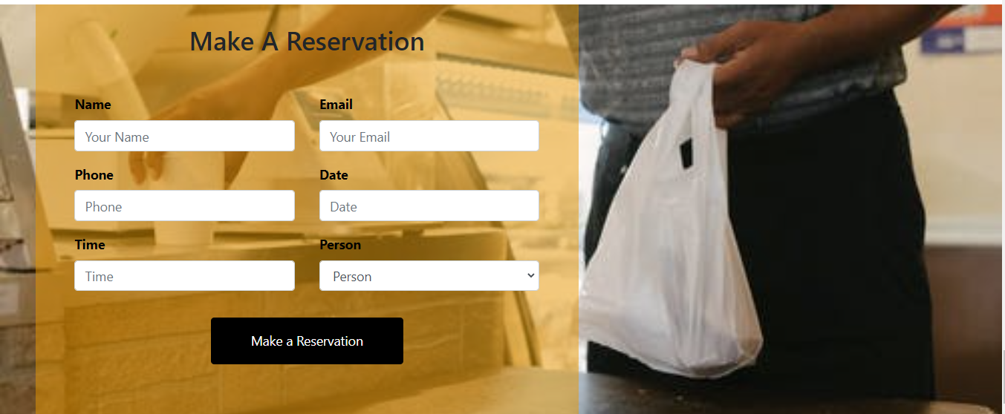

Slide 10
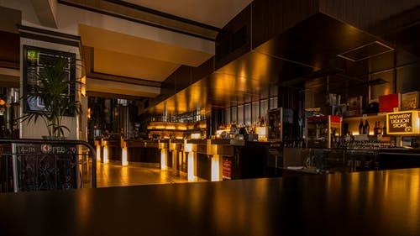
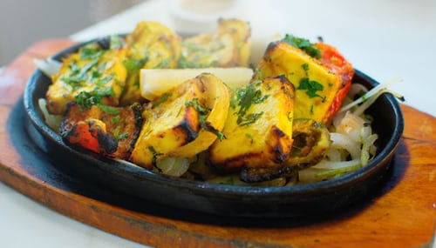
APPLICATIONS
Cake and sponge products
Cookies and biscuits
Doughnuts
Pastries
Crackers and snacks
Muffins
Pancakes and waffles
confectionery
Tortillas and pizza
Dry mixes

Slide 11

THANK YOU

